Slide 1
Implementation Forum „Identity & Attestation Management“

Slide 2
Compliance with applicable competition law and Antitrust Guidelines
NO PRICE-FIXING ​
NO MARKET OR CUSTOMER ALLOCATION ​
NO OUTPUT RESTRICTIONS ​
NO AGREEMENT ON OR EXCHANGE OF COMPETITIVELY SENSITIVE BUSINESS INFORMATION ​
CONSEQUENCES OF COMPETITION LAW INFRINGEMENT
Cf. Code of Conduct for Competition Law Compliance
https://gaia-x.eu/wp-content/uploads/files/2021-11/210308%20GAIA-X%20Code%20of%20Conduct%20for%20Competition%20Law%20Compliance.pdf

Slide 3
Agenda
1
What is an Implementation Forum & Why?
2
IF Identity & Attestation Management
3
Open Questions & Discussion
4
Outputs of this meeting
5
Event Update

Slide 4
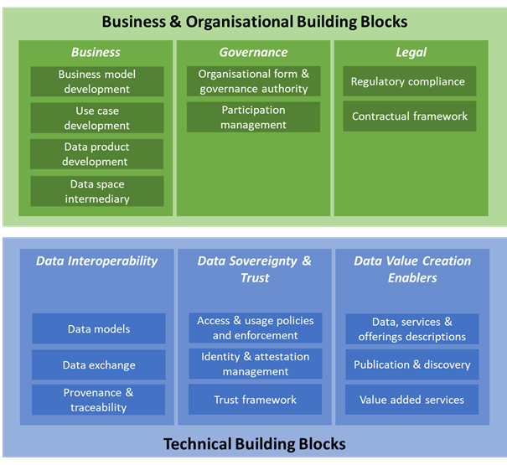
What is an Implementation Forum?
regular exchange format for data space designers, developers and work package leads
across (Gaia-X funded) projects and industries
focusing on implementation issues, not theoretical data space architecture questions
organised across the DSSC building blocks
community-driven exchange without central authority
not exclusively for Gaia-X, but overall data space issues
GOALS
→ accelerating development of new data spaces
→ creating strong competence networks
→ enabling scaling of initiatives & suppliers

Slide 5
Identity & Attestation Management
Summary
The reliability of information is a foundational element in building trust among participants in a data space and supporting its growth.
Based on a data space’s governance, mandatory information provided on the relevant entities must be verifiable to enable the onboarding and offboarding processes. The trustworthiness of information is linked to the trustworthiness of the Trust Anchors (or Trust Service Providers, specifically for identities), who are entitled to issue the respective attestations.
In particular, W3C standards and Qualified Electronic Attestation of Attributes provided by Qualified Trust Service Providers following eIDAS Regulation are leveraged.
Purpose
This building block provides an approach for managing identities and attestations while ensuring interoperability, security and trust, based on a decentralised view, through the use of widely recognised technical standards and regulatory frameworks.
https://dssc.eu/space/BVE/357075352/Identity+and+Attestation+Management

Slide 6
Identity & Attestation Management
Core design choices
Data spaces should consider the following design choices when considering Identity and Attestation Management :
How do you represent information about entities in a data space to make it verifiable and enable trust and interoperability?
How do you ensure the reliability of information on participants' identities?
How do you identify the participants in a data space?
https://dssc.eu/space/BVE/357075352/Identity+and+Attestation+Management#Core-design-choices

Slide 7
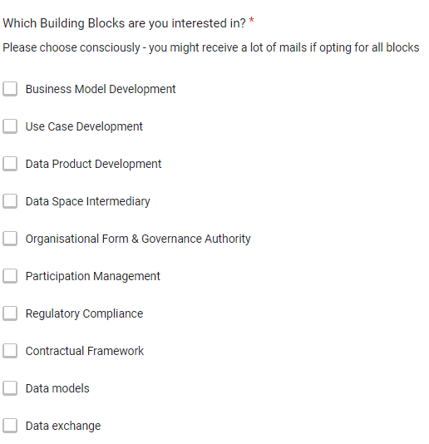
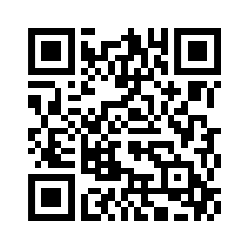
Please register for other Implementation Forums!
https://forms.gle/GQMnovsip7iLiwJYA

Slide 8




Open Questions & Discussion
Functional specifications
Attestations
Verifiable Credentials
Verifiable and Decentralised Digital Identity - Using DIDs
OpenID for Verifiable Credentials
Identity
Attestations on Participation in a Data Space
Attestations Indicating Compliance with Criteria Defined According to Data Space Governance
Recommended standards
Technical Specifications
Combination of W3C Standards to building and validating digital attestations
Implementation examples - usage of Party Credential for Identity, Authorisation and Authentication
Party Credential Status
Implementation example - Usage of VerifiableID Credential to enable the onboarding process
Components for Implementing This Building Block

Slide 9
Open Questions & Discussion
What’s your opinion on the concept?
Where should we focus on in this IF?
Include “access & usage policies and enforcement” and “trust framework” ?
What infrastructure should we use?
MS Teams for meetings → Gaia-X Hub Germany
Whiteboards?
Meeting Notes?
GitLab?
Mailing Lists → Gaia-X Hub Germany
Calendar for common events?

Slide 10
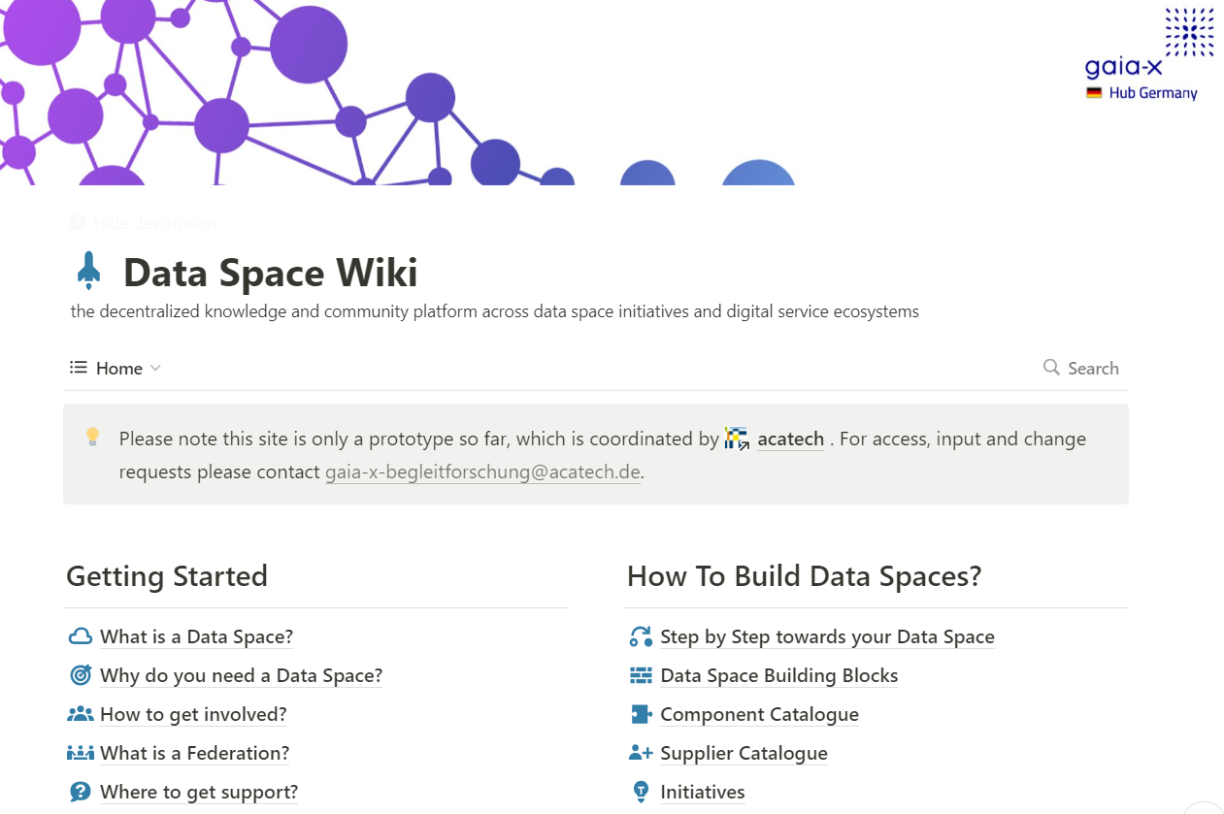
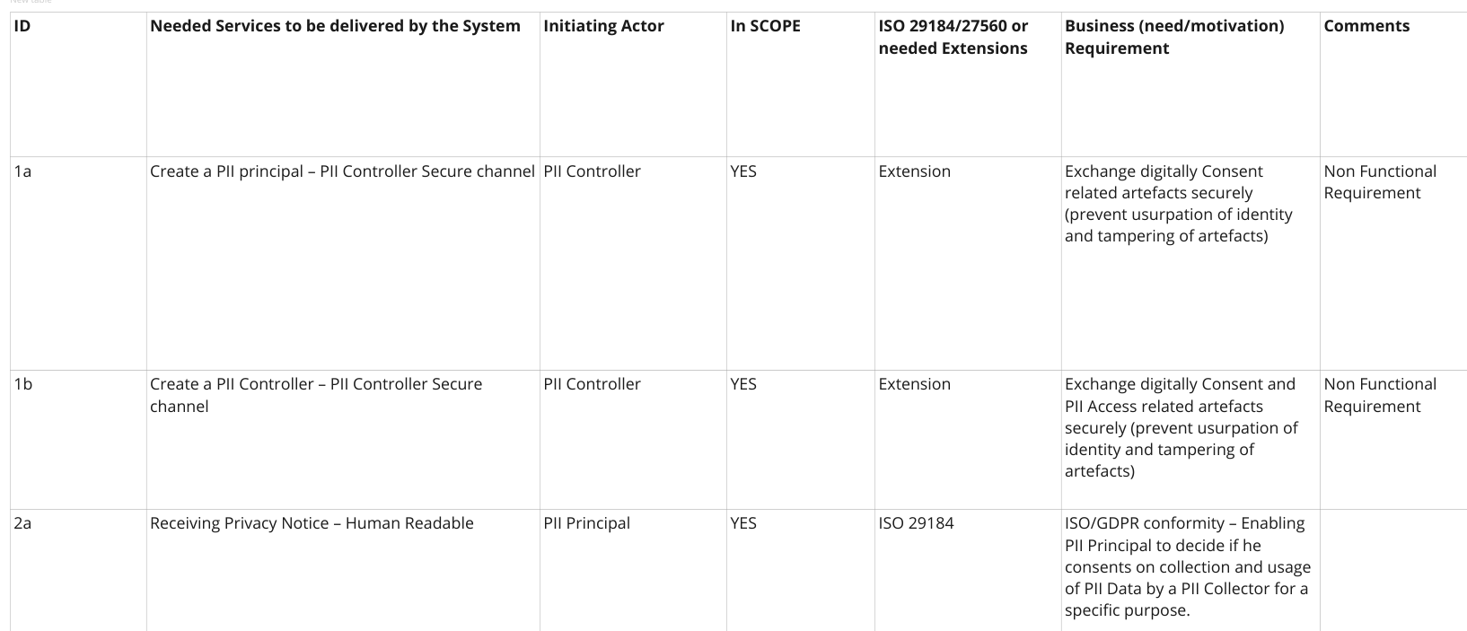
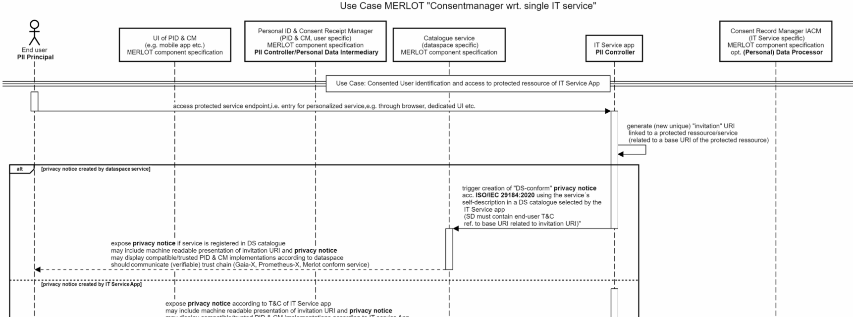
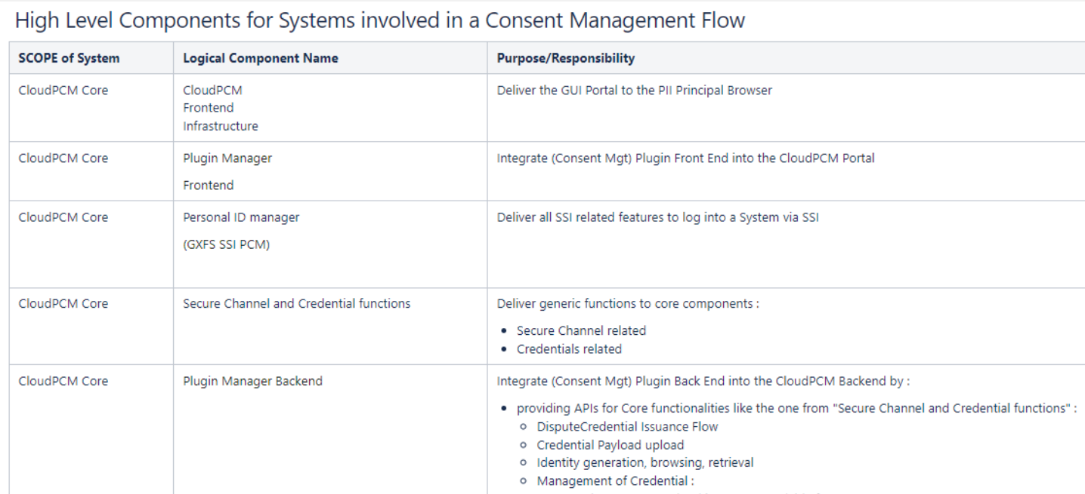
Outputs
Wiki Sites
Best Practice surveys & “implementation stories”
Overview of components, suppliers & consulting services
Process overviews
Feature & change requests & backlogs lists

Slide 11
Event Update
https://www.sprind.org/de/challenges/eudi-wallet-prototypes/
Webinar for EUDI Wallet Protoypes by German SPRIN-D agency
NOW: 18.04.2024 at 15:00 MEZ
Next meeting IF Identity & Attestion Management
09.05. Public Holiday in Germany & elsewhere
16.05. Tractus-X Community Days
23.05. Cloud Expo & Tech-X
30.05. Public Holiday in Germany & elsewhere

